Slide 1
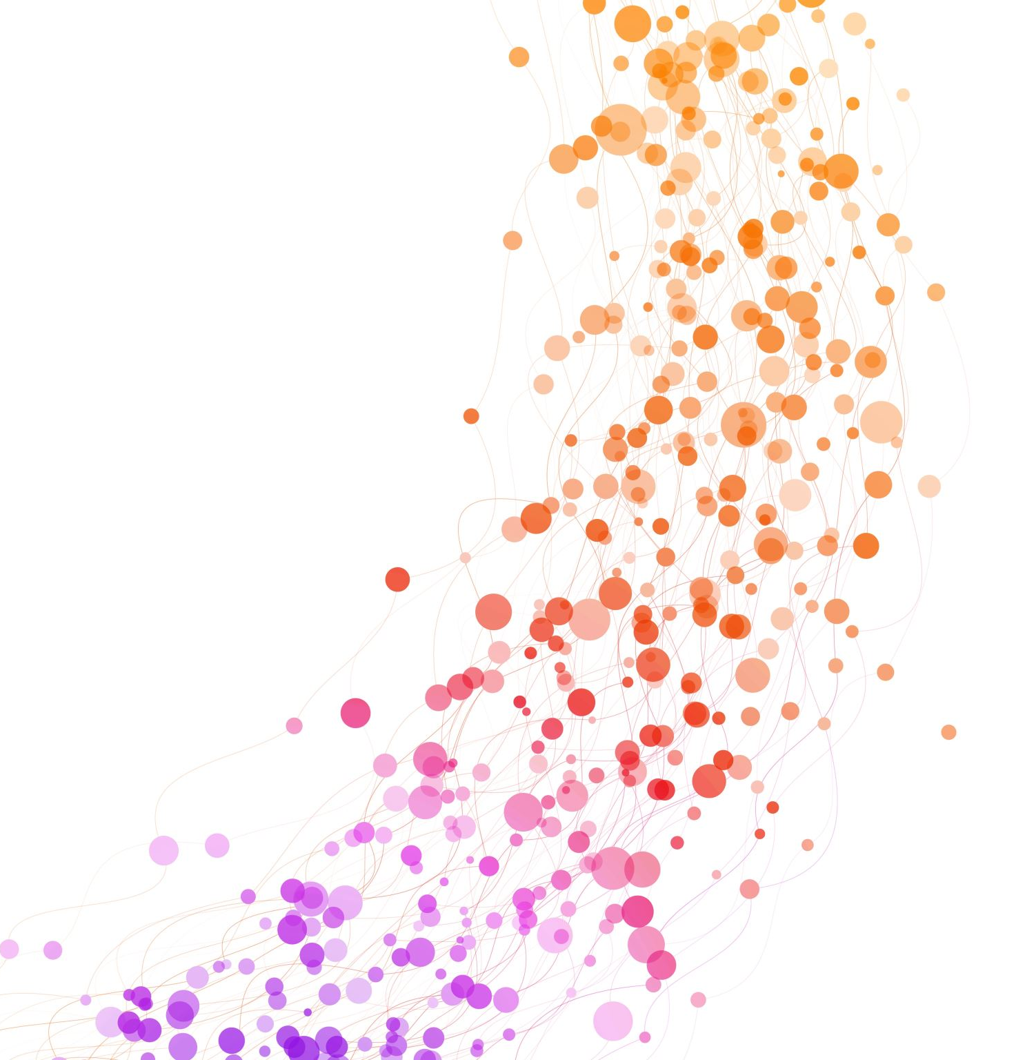
Supervisor Meeting - Friday

Slide 2
Guitar on Audio Transcription Dataset (GOAT)
SynthTab
5.9 hours of unique, Direct Input audio using various electric guitars and players
Includes string and fret numbers
Requires to request access due to using covers of popular songs (Emailed the research member)
13 hours of synthesised guitar audio (attempts to simulate human playing)
Using DadaGP dataset
String accurate and perfectly aligned with the ground truth tablature annotations
Main issue large folders
SynthTab: 2TB
GOAT: 500GB

Slide 3
Approaches of Automatic Guitar Transcription (AGT)
TabCNN (end-to-end solution)
Solves both the problems of pitch estimation and fretboard mapping
Predicts actual fingering of guitarist
Trained on GuitarSet
Not explicitly designed for guitar techniques
Fretting Transformer
Translates music notation into guitar tablature
Encoder-decoder model using T5 transformer architecture
Predicts string fret combination
Conditioned to work for different tunings and capo

Slide 4
Fretboard Mapping
Current Fretboard Mapping:
Greedy Heuristic
Nearest fret distance
No context (Does not factor in the previous or next fret)
Simple and fast
Fretboard CNN (midi to fretboard)
1-D Temporal Convolutional Network

Slide 5
Basic Pitch (Control)
Processing Evaluation...
=======================================================================
Total number of actual notes: 151
Total number of predicted notes: 146
•••••
True Positives: 96
False Positives: 50
False Negatives: 55
•••••
The precision of the model: 0.6575
The recall of the model: 0.6358
The F1-Score of the model: 0.6465

Slide 6
Basic Pitch + Preprocessing
Processing Evaluation...
=======================================================================
Total number of actual notes: 151
Total number of predicted notes: 109
•••••
True Positives: 64
False Positives: 45
False Negatives: 87
•••••
The precision of the model: 0.5872
The recall of the model: 0.4238
The F1-Score of the model: 0.4923

Slide 7
Basic Pitch + Postprocessing
Processing Evaluation...
=======================================================================
Total number of actual notes: 151
Total number of predicted notes: 111
•••••
True Positives: 84
False Positives: 27
False Negatives: 67
•••••
The precision of the model: 0.7568
The recall of the model: 0.5563
The F1-Score of the model: 0.6412

Slide 8
Basic Pitch + Pre + Postprocessing
Processing Evaluation...
======================================================================
•••••
True Positives: 58
False Positives: 21
False Negatives: 93
•••••
The precision of the model: 0.7342
The recall of the model: 0.3841
The F1-Score of the model: 0.5043

Slide 9
Next Plan
Evaluation metrics for mapping
Use a Pre-Trained Model (fine tuning)
Classification of guitar techniques
Light weight version to Tart?

